Slide 1
2023-04-17

Slide 2
Upcoming Schedule
Monday | Wednesday | Friday
04/17/2023 (90) • Review: Unit 5, Unit 9 • AP CS Question 2: Classes | 04/19/2023 (90) • Review: Units 6-7 • AP CS Question 3: Array/ArrayList | 04/21/2023 (45) • Review: Unit 10 • More recursion exercises like we did on Apr-7
04/24/2023 (90) • Review: Unit 8 • AP CS Question 4: 2D Array | 04/26/2023 (90) • AP CS Multiple Choice Game | 04/28/2023 (45) • Review: Unit 7, Unit 10 • Algorithms: Iterative/recursive binary search, selection sort, insertion sort, merge sort
05/01/2023 • FINAL | 05/03/2023 • AP EXAM

Slide 3
Unit 5 and Unit 9
AP CS FRQ 2 (Classes and Inheritance)

Slide 4
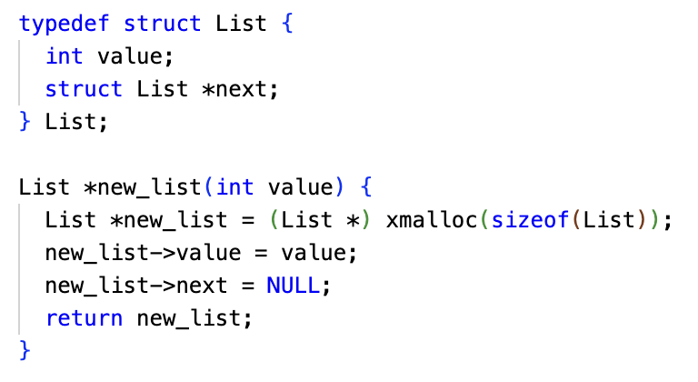
Object-Oriented Programming (OOP)
OOP is a programming methodology. It introduced the concepts of classes and objects.
Before OOP, the dominant paradigm was "structured programming." Code and data were separate. You'd organize your code into procedures/functions. For data, many languages had "records" or "structs"... essentially objects with just variables and no methods. OOP had the idea of packaging the methods and variables together.
OOP encourages you to think about objects as "actors" that you command to take actions, but how they do it internally is abstracted away.
OOP, like grunge, became huge in the early 90's, with languages like C++ and Smalltalk, and yes, Java.
It's still popular today, because it proved to be a great way to organize and maintain large, complex programs.
Old School Structured Programming:
Creating a linked list in C (not C++)

Slide 5
The Four Pillars of Object-Oriented Programming (OOP)
Abstraction | Objects provide an interface that external code interacts with. The implementation of the object is not of concern to external code; it is abstracted away, and could be changed without any alteration needed to calling code.
Encapsulation | The internal state of an object, such as variables, are bundled with it and hidden from external code.
Inheritance | Objects belong to classes, and classes inherit from other classes. Objects inherit the methods and variables of their superclasses. Related concept: Containment/Composition is when objects contain other objects.
Polymorphism | Circle and Square inherit from Shape, which defines a draw method. Each subclass of Shape implements the draw method with the code to draw the right shape. Calling code, working with collections of Shape, is indifferent to the particular type of Shape being drawn.

Slide 6
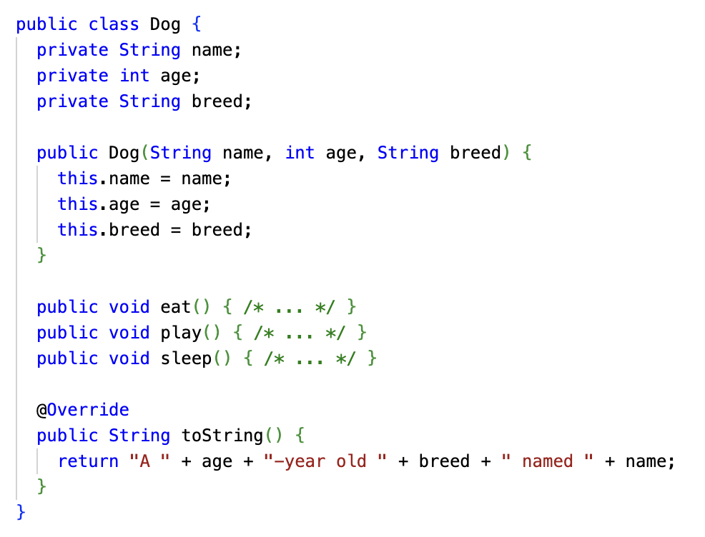
Definitions
Class: A blueprint for a type of object.
Object instance, or just object: An instantiation (copy) of a class created with the new operator. There can be many of them:
Dog roscoe = new Dog("Roscoe", 3, "German Shepherd"); Dog lucy = new Dog("Lucy", 1, "Golden Retriever");
Instance variables, also known as fields, attributes, or properties: Every instance gets their own copy of these variables. They hold the data for each object instance.
Constructor: Code that is run to initialize the object, optionally taking parameters passed using new.
Instance Methods: Operations that the object can perform. When instance variables are used, they are fetched from the instance the method was invoked on.

Slide 7
The Anatomy of a Constructor
Things to keep in mind:
The constructor name must always match the name of the class.
Always prepend the public keyword before your constructor name. (private constructors have their uses, but are less common.)
Constructors have no return type. Not even void!
The constructor definition is often included before any other method definitions (but is not required to be)
public class ClassName { // Instance Variable Declarations // Constructor - same name as Class, no return type public ClassName() { // Implementation not shown } // Other methods ... }

Slide 8
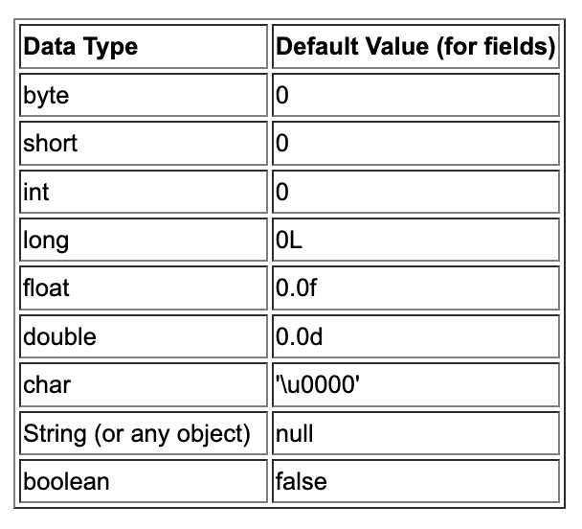
Instance Variable Initialization
Instance variables are typically assigned initial values by a constructor.
They can also be initialized as part of their declaration:
private boolean isAlive = true;
If you do not initialize an instance variable, it will be initialized to the default value for its type.
public class Person { private String name; private int age;
private boolean isAlive = true;
public Person(String name, int age) { this.name = name; this.age = age; } }

Slide 9
Types of Constructors
Default Constructor
No-Argument Constructor
Parameterized Constructor
Overloaded Constructors
Automatically generated by the Java compiler when you do not supply a constructor
Does not do any kind of specialized initialization of the instance beyond whatever in-place variable initialization exists, and default values
public class Person {
// No constructor defined
// Java creates a default constructor
}

Slide 10
Types of Constructors
Default Constructor
No-Argument Constructor
Parameterized Constructor
Overloaded Constructors
A constructor you define that takes no arguments
Can perform any kind of initialization that the the instance requires
No parameters can be passed in during new to customize the instance
public class Person {
private String name;
private int age;
public Person() {
name = "Billy";
age = 25;
}
}
When you define a Constructor (any kind) Java will NOT create a Default Constructor!

Slide 11
Types of Constructors
Default Constructor
No-Argument Constructor
Parameterized Constructor
Overloaded Constructors
A constructor you define that takes arguments
Can perform any kind of initialization that the the instance requires
Each instance can be initialized individually based on the values passed into new
public class Person {
private String name;
public Person(String initName) {
name = initName;
}
}

Slide 12
Types of Constructors
Default Constructor
No-Argument Constructor
Parameterized Constructor
Overloaded Constructors
A class may have multiple constructors
Each constructor must
have the same name as the class;
declare no return type
have a distinct set of parameter types
This is quite common. Sometimes, you want to be able to create an object with a default set of values, but also have the ability to specify values.
public class Person {
private String name;
private int age;
public Person() {
name = "Name unknown"; }
public Person(String initName) {
name = initName;
age = 30;
}
public Person(String initName, int initAge) {
name = initName;
age = initAge;
}
}

Slide 13
Types of Constructors
Default Constructor
No-Argument Constructor
Parameterized Constructor
Overloaded Constructors
One last cool trick...
You can call this() as a method within constructors, and it will chain to another constructor.
This is like super() constructor chaining, but it chains to a constructor in the same class, not a superclass. Like super(), it has to be the first statement in the constructor body.
Not needed for the AP exam.
I don't see people do it in the wild much, either... maybe they don't know about it :)
public class Person {
private String name;
private int age;
public Person() {
this("Name unknown"); }
public Person(String initName) {
this(initName, 30);
}
public Person(String initName, int initAge) {
name = initName;
age = initAge;
}
}

Slide 14
Preconditions and Postconditions
DEFINITELY on AP exam

Slide 15
Preconditions and Postconditions
Preconditions and postconditions are a "contract" that describes what a method requires about its inputs, and what it promises as output.
Precondition
Postcondition
index must be >= 0
and < length of string
public char charAt(int index);
character at index index will be returned
The caller must satisfy this requirement when calling charAt.
In return, the desired character will be returned.

Slide 16
Preconditions
Preconditions are part of the method's documentation, and may exist only as comments.
There is no expectation that the method will check to ensure preconditions are satisfied.
They may or may not be enforced by the method's code – the programmer using the method should read the documentation and understand the "contract" the method offers.
/**
* Precondition: num2 is not zero.
* Postcondition: Returns the quotient of num1 and num2.
*/
public double divide(double num1, double num2)
{
return num1 / num2;
}

Slide 17
Who enforces preconditions?
Sometimes preconditions ARE enforced by the method's code.
An actual implementation of Java's String.charAt:
Here, an exception is thrown if the precondition is not satisfied.
Throwing an exception in Java is a common way to handle failed preconditions.
public char charAt(int index) { if ((index < 0) || (index >= value.length)) { throw new StringIndexOutOfBoundsException(index); } return value[index]; }

Slide 18
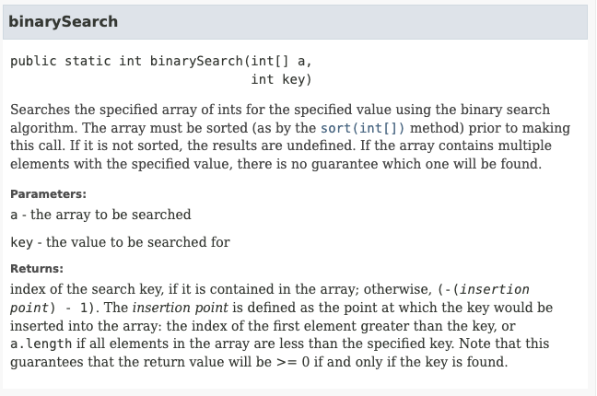
Who enforces preconditions?
At other times, it is not reasonable for the method to enforce the precondition.
The programmer calling the method must understand the preconditions and satisfy them.
The precondition here exists only as documentation, and describes the consequences of failing to meet it. (Where is the precondition?)

Slide 19
Postconditions
A postcondition is a condition that is true after running the method. It is what the method promises to do.
Postconditions describe the outcome of running the method, for example what is being returned or the changes to the instance variables.
Examples:
String.compareTo() The method returns 0 if the string is equal to the other string. A value less than 0 is returned if the string is less than the other string (less characters) and a value greater than 0 if the string is greater than the other string (more characters).
Math.random Returns a double value with a positive sign, greater than or equal to 0.0 and less than 1.0.

Slide 20
Access Control: private and public
private
A private method or variable may only be accessed by code within the class.
On the AP Exam, and most of the time IRL, all instance variables should be declared private.
Even a subclass of your class cannot access private variables!
If a method isn't part of the interface that other code should call, that is, if it's part of its internal implementation, it probably should be private.
public
A public method or variable may be accessed by any code, inside or outside of the class.

Slide 21
Accessor Methods
It is best practice to define your instance variables as private.
Still, code outside your class often needs to get the values in those variables.
For this reason, classes often define accessor methods, which are public methods that provide read-only access to private instance variables.
Sometimes, these are called "get methods" or "getters."
The return type matches the type of the variable being returned.
public class Person {
private String name;
public Person(String name) {
this.name = name;
}
public String getName() {
return name;
}
}

Slide 22
Accessor Methods
Accessor methods can also return a filtered or transformed version of the private variable.
This is the power of accessor methods – they abstract away the variable itself, so the way the phone number is represented here could be changed.
public class Person
{
private String phoneNumber;
...
public String getAreaCode() {
return phoneNumber.substring(0,3);
}
}

Slide 23
Mutator Methods
Mutator methods are the opposite of accessor methods...
They are public methods that modify internal private instance variables.
Sometimes these are called "set methods" or "setters."
These public methods typically have void return type, and take one parameter with the same type as the private instance variable being modified.
public class Person {
private String name;
public Person(String name) {
this.name = name;
}
public String getName() {
return name;
}
public void setName(String name) {
this.name = name;
}
}

Slide 24
Mutator Methods
Mutator methods can also filter, verify, or transform a value before assigning it to a private instance variable value.
public class Person
{
private String areaCode;
...
public void setAreaCode(String phoneNumber) {
areaCode = phoneNumber.substring(0,3);
}
}

Slide 25
Method Parameters: Pass by Value / Pass by Reference
Parameters of a method behave like local variables of the method. Each actual parameter is copied into one of these variables.
For primitive types, the variable contains a copy of the actual parameter. The method may change it, but it has no effect on any variables in the calling code.
int age = 16; Person p = new Person(age); // age is guaranteed to still be 16 public class Person { public Person(int initAge) { // initAge is a COPY of age initAge = 20; // does not alter the value of age in the caller } }
int
age
16
int
Person.Person() {
initAge
20
}

Slide 26
Method Parameters: Pass by Value / Pass by Reference
For object types, what is passed into the method is a reference to an object.
If the referenced object is mutable in any way, the method could make changes to it, and the caller would see those changes after the method returns.
int age = 16; Person p = new Person(age); // p.age == 16 Student s = new Student(p); // p.age == 20 public class Student { public Student(Person person) { // person is a REFERENCE to the same object in the caller person.age = 20; // alters the Person passed in from the the caller } }
Person
p
age: 20
Student.Student() {
person
}

Slide 27
static
static variables and methods are at class-level, not instance-level
There is only one copy of a static variable
static methods aren't run in the context of any particular instance (no this)
They can be public or private
Often, static variables are CONSTANT_VALUES and declared final
When using the dot operator, you typically use the name of the class, instead of a particular instance. (You can legally say instance.some_static, but it could just be confusing.)
Math.PI
Math.random()
Math.sqrt()
Within a class, you can just refer to a static member by name.
There's also the import static shorthand: import static java.lang.Math.*;
The main method is a static method. The JVM invokes it without new-ing up your main class.

Slide 28
Statics
Person.getNumPeople(); A> 0
Statics can directly access other Statics
Statics cannot directly access non-Statics
Non-Statics can directly access Statics
class Person { private static int numPeople = 0; private String name; public Person(String initName) { numPeople++; name = initName; } public static int getNumPeople() { // System.out.println(name); return numPeople; } public void report() { System.out.println(name + " is one of " + numPeople + " people"); } }

Slide 29
Statics
public static int getNumPeople() { // System.out.println(name); <- Nope. return numPeople; }
Statics can directly access other Statics
Statics cannot directly access non-Statics
Non-Statics can directly access Statics
class Person { private static int numPeople = 0; private String name; public Person(String initName) { numPeople++; name = initName; } public static int getNumPeople() { // System.out.println(name); return numPeople; } public void report() { System.out.println(name + " is one of " + numPeople + " people"); } }

Slide 30
Statics
Person p1 = new Person("Julie"); Person p2 = new Person("Bobby"); p1.report() B> Julie is one of 2 people
p1.getNumPeople();
C> 2
Statics can directly access other Statics
Statics cannot directly access non-Statics
Non-Statics can directly access Statics
class Person { private static int numPeople = 0; private String name; public Person(String initName) { numPeople++; name = initName; } public static int getNumPeople() { // System.out.println(name); return numPeople; } public void report() { System.out.println(name + " is one of " + numPeople + " people"); } }

Slide 31
Scope – what methods and variables are accessible
Class Level Scope Instance and static variables inside a Class.
Method Level Scope Local variables (including parameter variables) inside a method.
Block Level Scope Loop variables and other local variables defined inside of blocks of code with { }
public class Person { private String name;
private String email; public void print(int length) { for (int i = 0; i < length; i++) { System.out.println(name.charAt(i)); } } }

Slide 32
Scope – what methods and variables are accessible
Class Level Scope Instance and static variables inside a Class.
Method Level Scope Local variables (including parameter variables) inside a method.
Block Level Scope Loop variables and other local variables defined inside of blocks of code with { }
public class Person { private String name;
private String email; public void print(int length) { for (int i = 0; i < length; i++) { System.out.println(name.charAt(i)); } } }

Slide 33
Scope – what methods and variables are accessible
Class Level Scope Instance and static variables inside a Class.
Method Level Scope Local variables (including parameter variables) inside a method.
Block Level Scope Loop variables and other local variables defined inside of blocks of code with { }
public class Person { private String name;
private String email; public void print(int length) { for (int i = 0; i < length; i++) { System.out.println(name.charAt(i)); } } }

Slide 34
OOP & Inheritance
Inheritance allows your program to efficiently share common code between different objects (code reuse); helps you better organize your program in ways that model the real world; and create smaller units of maintenance and testing.

Slide 35
OOP & Inheritance
Inheritance allows your program to efficiently share common code between different objects (code reuse); helps you better organize your program in ways that model the real world; and create smaller units of maintenance and testing.
Person
name
address
Student
name
address
locker
Teacher
name
address
office

Slide 36
OOP & Inheritance & Generalization
Inheritance allows your program to efficiently share common code between different objects (code reuse); helps you better organize your program in ways that model the real world; and create smaller units of maintenance and testing.
Identifying and centralizing common information is called "generalization"
Person
name
address
Student
name
address
locker
Teacher
name
address
office

Slide 37
OOP & Inheritance & Generalization
Inheritance allows your program to efficiently share common code between different objects (code reuse); helps you better organize your program in ways that model the real world; and create smaller units of maintenance and testing.
Person
name
address
Student
{Person}
locker
Teacher
{Person}
office

Slide 38
OOP & Inheritance & Generalization & Specialization
Inheritance allows your program to efficiently share common code between different objects (code reuse); helps you better organize your program in ways that model the real world; and create smaller units of maintenance and testing.
Placing class-specific information in that class is called "specialization"
Person
name
address
Student
{Person}
locker
Teacher
{Person}
office

Slide 39
Java & Inheritance
Any class not marked final can be used as a superclass.
To be a subclass of something other than Object, use the extends keyword.
class Person { public String name; public String address; }
class Teacher extends Person { public String office; }
class Student extends Person { public String locker; }
Person
name
address
Java extends only allows a single class name - this is called single-inheritance.
Teacher
office
Student
locker

Slide 40
Java & Inheritance
Subclasses inherit all the public variables and methods of their superclass
class Person { public String name; public String address; public void printInfo() { System.out.println(name + " " + address); } } class Teacher extends Person { public String office; } class Student extends Person { public String locker; } | Person p = new Person(); p.name = "Gary"; p.address = "San Francisco"; p.printInfo(); Teacher t = new Teacher(); t.name = "Chris"; t.address = "San Mateo"; t.printInfo(); t.office = "215W"; Student s = new Student(); s.name = "Beatrice"; s.address = "Colma"; s.printInfo(); s.locker = "B32";

Slide 41
Java & Inheritance
Classes that do not use the extends keyword automatically extend the Object class (has been happening for every class created since Unit 5)
class Object { public String toString(); public boolean equals(Object obj); ... } class Account { public String name; public double balance; } | Object o = new Object(); o.toString(); o.equals(void); Account a = new Account(); a.toString(); a.equals(void); a.name = "Amazon"; a.balance = 0.0;

Slide 42
Java & Inheritance & is-a relationships
Using Inheritance results in classes that have is-a relationships
class Account {} | Account is-a Object
class Person {} class Teacher extends Person {} class Student extends Person {} | Person is-a Object Teacher is-a Person / Teacher is-a Object Student is-a Person / Student is-a Object
class Animal {} class Dog extends Animal {} class Snake extends Animal {} | Animal is-a Object Dog is-a Animal / Dog is-a Object Snake is-a Animal / Snake is-a Object
class Shape {} class Square extends Shape {} class Circle extends Shape {} class Triangle extends Shape {} class Pentagon extends Shape {} | Shape is-a Object Square is-a Shape / Square is-a Object Circle is-a Shape / Circle is-a Object Triangle is-a Shape / Triangle is-a Object Pentagon is-a Shape / Pentagon is-a Object

Slide 43
Java & Inheritance & is-a relationships
The instanceof operator in Java can be used to test for is-a relationships
class Account {} | Account a = new Account(); System.out.println(a instanceof Object); // true System.out.println(a instanceof Account); // true
class Person {} class Teacher extends Person {} | Person p = new Person(); System.out.println(p instanceof Object); // true System.out.println(p instanceof Person); // true Teacher t = new Teacher(); System.out.println(t instanceof Object); // true System.out.println(t instanceof Person); // true System.out.println(t instanceof Teacher); // true

Slide 44
Containment & has-a relationships
Another concept utilized by Object-Oriented programming languages is Containment - where a class is responsible for maintaining an instance of another class inside itself. This results in a has-a relationship. We have been using this quite a lot in our examples and projects
class Test { public String name; public double score; } class Course { public String name; public Test tests[10]; } class Student { public String name; public Course courses[5]; } | Test has-a String (name) Course has-a String (name) Course has-a Test[] (tests) Student has-a String (name) Student has-a Course[] (courses)

Slide 45
Modeling is-a & has-a Relationships
 |  |  | is-a OR has-a
Pet | Cat | Dog | Dog is-a Pet Cat is-a Pet
Student | Teacher | Class | Class has-a Teacher Class has-a Student
Book | Movie | Media | Movie is-a Media Book is-a Media
Circle | Shape | Square | Circle is-a Shape Square is-a Shape
Lunch | Meal | Food | Lunch is-a Meal Meal has-a Food

Slide 46
Java & Inheritance
Note: Not a best practice to make these public
Subclasses can only access the public variables and public methods of their superclass
class Person { public String name; public String address; public void printInfo() { String info = buildInfoString(); System.out.println(info); } private String buildInfoString() { return name + " " + address; } } class Teacher extends Person { public String office; public String getBuildInfoString() { return buildInfoString(); ** ERROR ** } } | Person p = new Person(); p.name = "Gary"; p.address = "San Francisco"; p.printInfo(); Teacher t = new Teacher(); t.name = "Chris"; t.address = "San Mateo"; t.printInfo(); t.buildInfoString(); ** ERROR ** t.office = "215W";

Slide 47
Java & Inheritance
Note: This is the better practice - Keep your variables private unless you want other code to mess with 'em!
But what happens if items in the superclass are not public?
class Person { private String name; private String address; public Person(String name, String address) { this.name = name; this.address = address; } public void printInfo() { System.out.println(name + " " + address); } } class Teacher extends Person { private String office; ... } | Person p = new Person("Gary", "San Francisco"); p.printInfo();

Slide 48
Java & Inheritance
But what happens if items in the superclass are not public?
class Person { private String name; private String address; public Person(String name, String address) { this.name = name; this.address = address; } public void printInfo() { System.out.println(name + " " + address); } } class Teacher extends Person { private String office; ... } | Person p = new Person("Gary", "San Francisco"); p.printInfo();
error: constructor Person in class Person cannot be applied to given types;
class Teacher extends Person {
^
required: String,String
found: no arguments
reason: actual and formal argument lists differ in length

Slide 49
Java & Inheritance
But what happens if items in the superclass are not public?
class Person { private String name; private String address; public Person(String name, String address) { this.name = name; this.address = address; } public void printInfo() { System.out.println(name + " " + address); } } class Teacher extends Person { private String office; ... } | Person p = new Person("Gary", "San Francisco"); p.printInfo();
Reminder: If you declare any Constructor, Java will no longer automatically create a no-param constructor for you.
In this example, since Person has a Constructor that requires two parameters, there is no way to create a Person with zero parameters.
And this error is telling you that Teacher is malformed because there is no way to properly create its Person superclass.
error: constructor Person in class Person cannot be applied to given types;
class Teacher extends Person {
^
required: String,String
found: no arguments
reason: actual and formal argument lists differ in length

Slide 50
Java & Inheritance
Solution 1: Add a no-param constructor to Person
But what happens if items in the superclass are not public?
class Person { private String name; private String address; public Person(String name, String address) { this.name = name; this.address = address; } public void printInfo() { System.out.println(name + " " + address); } } class Teacher extends Person { private String office; ... } | Person p = new Person("Gary", "San Francisco"); p.printInfo();

Slide 51
Java & Inheritance
Solution 1: Add a no-param constructor to Person
But what happens if items in the superclass are not public?
class Person { private String name; private String address; public Person() { // empty } public Person(String name, String address) { this.name = name; this.address = address; } public void printInfo() { System.out.println(name + " " + address); } } class Teacher extends Person { private String office; } | Person p = new Person("Gary", "San Francisco"); p.printInfo(); Teacher t = new Teacher();
Adding a no-param constructor to Person "fixes" the error - Java now has a way to create a Teacher and its Person superclass.
But did this really fix the issue?

Slide 52
Java & Inheritance
Solution 1: Add a no-param constructor to Person
But what happens if items in the superclass are not public?
class Person { private String name; private String address; public Person() { // empty } public Person(String name, String address) { this.name = name; this.address = address; } public void printInfo() { System.out.println(name + " " + address); } } class Teacher extends Person { private String office; } | Person p = new Person("Gary", "San Francisco"); p.printInfo(); Teacher t = new Teacher(); t.printInfo();
Adding a no-param constructor to Person "fixes" the error - Java now has a way to create a Teacher and its Person superclass.
But did this really fix the issue?
Q: What is the output of t.printInfo()? A: null null

Slide 53
Java & Inheritance
Solution 1: Add a no-param constructor to Person
But what happens if items in the superclass are not public?
class Person { private String name; private String address; public Person() { // empty } public Person(String name, String address) { this.name = name; this.address = address; } public void printInfo() { System.out.println(name + " " + address); } } class Teacher extends Person { private String office; } | Person p = new Person("Gary", "San Francisco"); p.printInfo(); Teacher t = new Teacher(); t.printInfo();
Adding a no-param constructor to Person "fixes" the error - Java now has a way to create a Teacher and its Person superclass.
But did this really fix the issue?
Q: What is the output of t.printInfo()? A: null null
So let's try something else...

Slide 54
Java & Inheritance
Solution 2: Call the Person constructor from a Teacher constructor using super()
But what happens if items in the superclass are not public?
class Person { private String name; private String address; public Person(String name, String address) { this.name = name; this.address = address; } public void printInfo() { System.out.println(name + " " + address); } } class Teacher extends Person { private String office; public Teacher() { super("<a name>","<an adddress>"); } } | Person p = new Person("Gary", "San Francisco"); p.printInfo(); Teacher t = new Teacher(); t.printInfo();

Slide 55
Java & Inheritance
Solution 2: Call the Person constructor from a Teacher constructor using super()
But what happens if items in the superclass are not public?
class Person { private String name; private String address; public Person(String name, String address) { this.name = name; this.address = address; } public void printInfo() { System.out.println(name + " " + address); } } class Teacher extends Person { private String office; public Teacher() { super("<a name>","<an adddress>"); } } | Person p = new Person("Gary", "San Francisco"); p.printInfo(); Teacher t = new Teacher(); t.printInfo();
Subclasses can invoke a constructor in their superclass with super()
1) super() may only be used on the first line of a subclass constructor
2) the params you pass to super() determine which superclass constructor is invoked

Slide 56
Java & Inheritance
Solution 2: Call the Person constructor from a Teacher constructor using super()
But what happens if items in the superclass are not public?
class Person { private String name; private String address; public Person(String name, String address) { this.name = name; this.address = address; } public void printInfo() { System.out.println(name + " " + address); } } class Teacher extends Person { private String office; public Teacher() { super("<a name>","<an adddress>"); } } | Person p = new Person("Gary", "San Francisco"); p.printInfo(); Teacher t = new Teacher(); t.printInfo();
Subclasses can invoke a constructor in their superclass with super()
1) super() may only be used on the first line of a subclass constructor
2) the params you pass to super() determine which superclass constructor is invoked
Q: Now what is the output of t.printInfo()? A: <a name> <an address>

Slide 57
Java & Inheritance
Solution 2: Call the Person constructor from a Teacher constructor using super()
But what happens if items in the superclass are not public?
class Person { private String name; private String address; public Person(String name, String address) { this.name = name; this.address = address; } public void printInfo() { System.out.println(name + " " + address); } } class Teacher extends Person { private String office; public Teacher() { super("<a name>","<an adddress>"); } } | Person p = new Person("Gary", "San Francisco"); p.printInfo(); Teacher t = new Teacher(); t.printInfo();
Subclasses can invoke a constructor in their superclass with super()
1) super() may only be used on the first line of a subclass constructor
2) the params you pass to super() determine which superclass constructor is invoked
Q: Now what is the output of t.printInfo()? A: <a name> <an address>
Better - But probably still not the best solution...

Slide 58
Java & Inheritance
Solution 3: Invoke super() from a 2-param Teacher constructor
But what happens if items in the superclass are not public?
class Person { private String name; private String address; public Person(String name, String address) { this.name = name; this.address = address; } public void printInfo() { System.out.println(name + " " + address); } } class Teacher extends Person { private String office; public Teacher(String name, String address) { super(name, address); } } | Person p = new Person("Gary", "San Francisco"); p.printInfo(); Teacher t = new Teacher("Chris", "Thilgen"); t.printInfo();

Slide 59
Java & Inheritance
Solution 3: Invoke super() from a 2-param Teacher constructor
But what happens if items in the superclass are not public?
class Person { private String name; private String address; public Person(String name, String address) { this.name = name; this.address = address; } public void printInfo() { System.out.println(name + " " + address); } } class Teacher extends Person { private String office; public Teacher(String name, String address) { super(name, address); } } | Person p = new Person("Gary", "San Francisco"); p.printInfo(); Teacher t = new Teacher("Chris", "San Mateo"); t.printInfo();
Q: Now what is the output of t.printInfo()? A: Chris San Mateo

Slide 60
Java & Inheritance
Solution 3: Invoke super() from a 2-param Teacher constructor
But what happens if items in the superclass are not public?
class Person { private String name; private String address; public Person(String name, String address) { this.name = name; this.address = address; } public void printInfo() { System.out.println(name + " " + address); } } class Teacher extends Person { private String office; public Teacher(String name, String address) { super(name, address); } } | Person p = new Person("Gary", "San Francisco"); p.printInfo(); Teacher t = new Teacher("Chris", "San Mateo"); t.printInfo();
Q: Now what is the output of t.printInfo()? A: Chris San Mateo
Huzzah!

Slide 61
Java & Inheritance
Summary
Subclasses cannot access private variables and methods of a superclass Solution: Create accessor methods or carefully use protected
Subclasses can use super() to invoke superclass constructors
super() can only be used on the first line of a subclass constructor (to prevent subclasses from interfering with the creation of the superclass)
The params passed to super() determine which constructor in the superclass is invoked
If you do not add a call to super() in a subclass constructor, Java will automatically add super() It will call the no-param constructor of the superclass. This ensures that any initialization done by the superclass happens properly.

Slide 62
Overriding Methods
Method Overriding - To implement a new version of a method to replace code that would otherwise have been inherited from a superclass
To override a method from a superclass, implement the method in the subclass.
public class Turtle {
private int x, y;
public void forward(int z) {
x += z;
} public int getX() { return x; } public void setX(int x) { this.x = x; } }
public class TurboTurtle extends Turtle {
public void forward(int z) {
setX(getX() + 100*z);
}
}
// QUESTION: Why did we have to use the // accessor methods in TurboTurtle instead // of just saying x += 100*z?

Slide 63
Confuseth them not: Overloading and Overriding
We learned previously about Method Overloading: defining methods with the same name but different method signatures.
When you overload a method, you implement a new method with the same name but different parameters.
Overriding a method is very different than overloading a method.
Overriding replaces an inherited method.
Overloading creates a complementary method with the same name.
Overloading
public class MyMath {
public double sqr(double x) { ... }
public int sqr(int x) { ... }
}
Overriding
public class MyBetterMath extends MyMath {
// I have come up with a FASTER, // more efficient method to square // doubles!
@Override public double sqr(double x) { ... }
}

Slide 64
Failure To Override
class Base {
public void method() { System.out.println("Base.method"); }
}
class OverrideTest extends Base {
public void methud() { System.out.println("OverrideTest.method"); }
public static void main(String args[]) { new OverrideTest().method(); }
}
To override a method, you must match the method signature exactly. (Parameter names can be different... but the method name, return type, and parameter types must all match.) If you don't match it up, you may accidentally create an overloaded method! And the compiler will not warn you.
Accidental typo

Slide 65
@Override
Trying to override: public boolean equals(Object other); in class Object
class Rectangle {
@Override
public boolean equals(Rectangle other) { return other != null && left == other.left && top == other.top && right == other.right && bottom == other.bottom; }
}
Annotations are additional information that can be specified on Java methods, variables and classes. They start with @
@Override is an annotation which tells the compiler that you're trying to override a method... and if your declaration doesn't actually override a method, you get a helpful compile error.
(Why an annotation, not a keyword like C#? Adding keywords to an existing language is hard.)
Rectangle.java:3: error: method does not override or implement a method from a supertype
@Override
^
1 error

Slide 66
The Object Superclass
All classes are subclasses of the Object class.
(Not necessarily direct subclasses... there are often some superclasses in between.)
When you code, you want to use as specific a type as you can, but this is legal: Object myObject = "Hello, world!";
because every String is also an Object.
You also can assign a String to an Object variable, or otherwise use a String in any Object context.
It is always legal and requires no special syntax to convert a reference to a superclass reference: String myString = "Hello, world!"; Object myObject = myString;

Slide 67
The Object Superclass
The Object class lives in the java.lang package, which is where classes fundamental to the Java language live, like java.lang.String.
Object has several public methods. This means that all Java objects inherit these methods. Many of them can be overridden.
Some of the most common ones to override are:
public String toString();
public boolean equals(Object o);

Slide 68
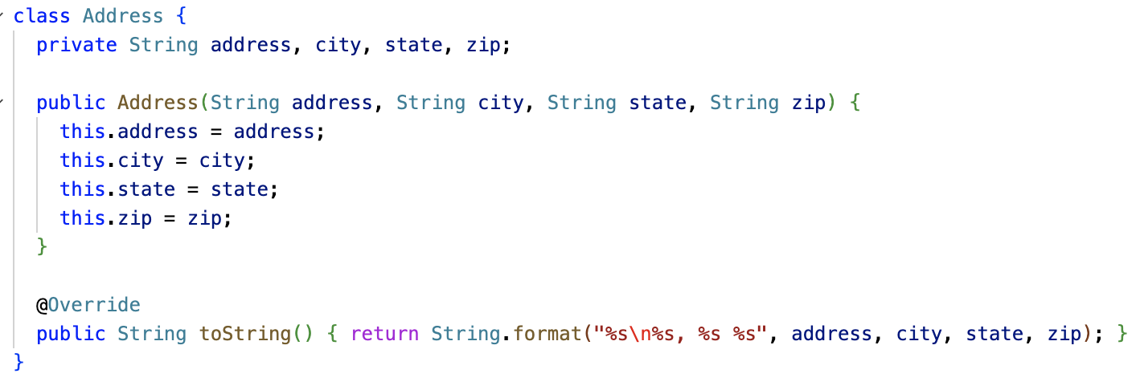
Overriding the toString method

Slide 69
Overriding the equals method
Note that the equals method compares the object with type Object.
So any object can be compared with any other object, of any class, using the equals method!
However, you often want your object to only be equal to objects of the same class, and you may need to compare member variables specific to your class.
What happens if you don't override Object.equals? The default implementation is essentially the same as == on reference types: It returns true if the other object is the exact same object instance.
@Override public boolean equals(Object o) { // returns true or false }
Careful:
public boolean equals(MyClass o) is NOT an override of Object.equals... It would make a separate overloaded method, with no warning/error unless you say @Override!

Slide 70
Casting
The type cast operator () makes it possible to convert a reference of superclass type (such as Object) to a subclass type (such as Student).
This only works if the superclass reference really IS pointing to an instance of the subclass!
If it isn't, a ClassCastException will be thrown.
NOTE: You do NOT need the (cast) operator to go from a subclass type to a superclass! Object obj = new String("Hello");
class Student { private String name; private String id; @Override public boolean equals(Object o) { if (o == null) { return false; } Student student = (Student)o; return name.equals(student.name) && id.equals(student.id); } }
Bug: This could throw
ClassCastException, if one passes, say, a Date or String to this method.

Slide 71
instanceof operator
The instanceof operator lets you check the "is-a" relationship of an object with a class.
x instanceof T evaluates to true if the object reference x is of type T.
Using instanceof, we can check that the cast to Student is safe before doing it.
An alternative is to try/catch ClassCastException, but that's more expensive.
class Student { private String name; private String id; @Override public boolean equals(Object o) { if (o == null || !(o instanceof Student)) { return false; } Student student = (Student)o; return name.equals(student.name) && id.equals(student.id); } }

Slide 72
Object.equals contract
Java defines a contract that Object.equals implementations must follow:
Reflexive: x.equals(x) is true
Symmetric: if x.equal(y) is true, y.equals(x) is true
Transient: if x.equals(y) and y.equals(z) are true, x.equals(z) is true
Consistent: x.equals(y) should return the same thing if you call it again, if nothing about them changed
Handles null: x.equals(null) should return false. (And it shouldn't crash with a NullPointerException!)
class Student { private String name; private String id; @Override public boolean equals(Object o) { if (o == null || !(o instanceof Student)) { return false; } Student student = (Student)o; return name.equals(student.name) && id.equals(student.id); } }

Slide 73
super.method()
class Person { ... public void dump(PrintWriter pw) { pw.println("Name: " + name); } } class Teacher extends Person { private String classroom; ... public void dump(PrintWriter pw) { super.dump(pw); System.out.println("Classroom: " + classroom); } }
We've seen the super keyword used for constructor chaining, where a subclass constructor calls a superclass constructor.
The super keyword can also be used to invoke a superclass's version of a method, even if the subclass overrides the method.
Often, an overridden method wants to do everything the original method did, but add on some additional behavior.

Slide 74
super.method() and super() differences
If you don't use super in a subclass constructor, Java does it for you. It adds an implicit super() to call the no-param constructor of the superclass, if one exists.
This is done because Java regards constructors as important to making a properly initialized object. You can't skip around a superclass constructor.
Method overrides are different. Java lets you completely replace the definition of a method. The new method code has a choice: It can use super.method() to call the superclass version of the method at some point, or not.
class NPC { ... public void tick() { // Implements random movement of the NPC // around the map } } class Teacher extends NPC { ... public void tick() { // call super.tick() to get the basic NPC behavior // like random movement super.tick(); // Additional code here for special NPC behavior // specific to this character } }

Slide 75
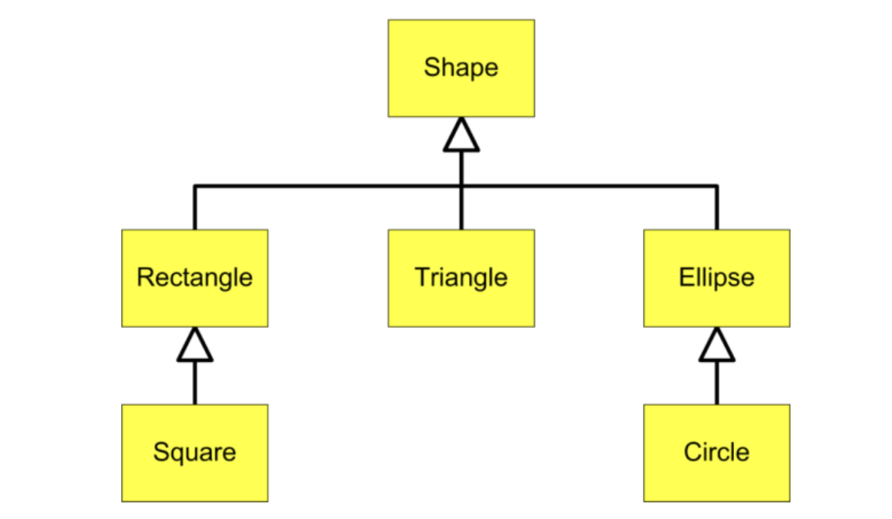
Inheritance Hierarchy
When you use multiple layers of inheritance, this creates a set of relationships called an inheritance hierarchy – most often illustrated as a tree.

Slide 76
Inheritance Hierarchy
This Inheritance Hierarchy shows the relationships between various geometric shapes.
Remember: In UML (Unified Modeling Language) child classes point to parent classes with open triangle endpoints
Circle is-a Ellipse
Ellipse is-a Shape
Triangle is-a Shape
A Square is-a Rectangle
Rectangle is-a Shape

Slide 77
Inheritance Hierarchy
This Inheritance Hierarchy shows the relationships between various geometric shapes.
Remember: In UML (Unified Modeling Language) child classes point to parent classes with open triangle endpoints
Circle is-a Ellipse
Ellipse is-a Shape
Triangle is-a Shape
A Square is-a Rectangle
Rectangle is-a Shape
Circle and Square are also Shapes; They satisfy the is-a relationship test with Shape

Slide 78
Inheritance Hierarchy
The is-a relationship allows you to make use of different types of variable types to hold references to different types of objects.
Circle c = new Circle(); Ellipse e = c; Shape s = c;

Slide 79
Inheritance Hierarchy
The is-a relationship allows you to make use of different types of variable types to hold references to different types of objects.
Circle c = new Circle(); Ellipse e = c; Shape s = c;
This means you can create an Array/ArrayList of Shapes and add any of these objects to it.

Slide 80
Inheritance Hierarchy
But this only works in one direction - subclass types can become superclass types; but superclass types cannot become subclass types Circle is-a Ellipse Ellipse is-a Shape
Shape s = new Shape() Rectangle r = s; **ERROR** Triangle t = s; **ERROR** Ellipse e = e; **ERROR**

Slide 81
Compile Time, Run Time
Java is a compiled language. (Unlike Python, which is interpreted.)
A program must be compiled using the Java compiler, that is, turned into 1's and 0's that the Java Virtual Machine understands.
The Java Virtual Machine then can execute the resulting Java bytecode.
The Java compiler reads your Java source code (.java files)
Compilation checks your program for syntax errors (missing semicolons, curly braces, etc.) as well as semantic errors (incompatible types, etc.) This produces compile errors.
This is the program that yells at you if you try to use a variable before you’ve initialized it.
But you can also encounter run-time errors (usually Java exceptions)
For example, an error message that says you tried to divide by zero
These kinds of error can’t be identified a priori–your code needs to be run for these issues to be caught

Slide 82
Polymorphism
We had these reversed in the 9.6 slides. They have been updated.
In Java, an object variable has both a declared type (compile-time type) and an actual type (run-time type).
The declared type is the type that is used in the declaration.
The actual type is the class that was actually used to create the object using new.
class Shape { public void draw() { System.out.println(this.getClass()); } } class Rectangle extends Shape {} class Triangle extends Shape {} class Ellipse extends Shape {} | Shape shapes[] = new Shape[3]; shapes[0] = new Rectangle(); shapes[1] = new Triangle(); shapes[2] = new Ellipse(); for (Shape s : shapes) { s.draw(); }

Slide 83
Polymorphism
In Java, an object variable has both a declared type (compile-time type) and an actual type (run-time type).
The declared type is the type that is used in the declaration.
The actual type is the class that was actually used to create the object using new.
class Shape { ... }
class Rectangle extends Shape { ... }
Shape shape = new Rectangle();
Declared Type
(Compile-Time Type)
Actual Type
(Run-Time Type)
What the compiler is doing its type checking against, e.g., when it is determining what methods are available to call.
What the object actually is at run-time, which dictates how it will actually behave when methods are invoked.

Slide 84
Polymorphism
In this example, the declared type of shapes[i] is Shape.
The actual types, however, are Rectangle, Triangle, and Ellipse.
class Shape { public void draw() { System.out.println(this.getClass()); } } class Rectangle extends Shape {} class Triangle extends Shape {} class Ellipse extends Shape {} | Shape shapes[] = new Shape[3]; shapes[0] = new Rectangle(); shapes[1] = new Triangle(); shapes[2] = new Ellipse(); for (Shape s : shapes) { s.draw(); }

Slide 85
Polymorphism
When you use new, an instance of a specific type is created. This instance will always have that actual type, even if you put it in a variable with a declared type of a superclass.
The elements of shapes have declared type of Shape, but actual types of Rectangle, Triangle, and Ellipse (because that is the type that was created with new)
class Shape { public void draw() { System.out.println(this.getClass()); } } class Rectangle extends Shape {} class Triangle extends Shape {} class Ellipse extends Shape {} | Shape shapes[] = new Shape[3]; shapes[0] = new Rectangle(); shapes[1] = new Triangle(); shapes[2] = new Ellipse(); for (Shape s : shapes) { s.draw(); } > class Rectangle > class Triangle > class Ellipse

Slide 86
Polymorphism
The actual type of an object is whatever class was used with the new operator.
That object could be referenced by a variable of a superclass type. The declared type is used by the compiler to determine the available methods. The method called, though, depends on the actual type of the object. The object's class may override that method.
class Shape { public void draw() { System.out.println(this.getClass()); } } class Rectangle extends Shape {} class Triangle extends Shape {} class Ellipse extends Shape {} | Shape shapes[] = new Shape[3]; shapes[0] = new Rectangle(); shapes[1] = new Triangle(); shapes[2] = new Ellipse(); for (Shape s : shapes) { s.draw(); } > class Rectangle > class Triangle > class Ellipse
We can invoke s.draw() because draw is a method of Shape. The actual draw method that is invoked depends on the actual type of each object. Rectangle, Triangle, and Ellipse may override draw.

Slide 87
Polymorphism
At compile-time
The compiler uses the declared type / compile-time type to verify that the methods you are trying to use are available to an object of that type.
The code won’t compile if the methods don’t exist in that class or some superclass.
Shape s = new Rectangle();
At run-time
The Java Virtual Machine uses the run-time type to determine which methods are used
When a method is called, the JVM checks whether the run-time type overrides the method, and runs the overridden version of the method if so.
Because s is declared as Shape, only Shape methods can be invoked on s, even though it's really a Rectangle!

Slide 88
Polymorphism
Polymorphic Assignment
Shape s = new Rectangle();
Polymorphic Parameters
public void print(Shape s){}
Polymorphic Collections
Shape[] shapeArray = { new Rectangle(), new Square() };

Slide 89
Polymorphism
Polymorphic Assignment
Shape s = new Rectangle();
Polymorphic Parameters
public void print(Shape s){}
Polymorphic Collections
Shape[] shapeArray = { new Rectangle(), new Square() };
There are no errors at compile-time because the compiler checks that the “subclass is-a superclass” relationship is true.
At run-time, the Java runtime will use the object’s actual subclass type and call the subclass methods for any overridden methods.
This is why they are polymorphic – the same code can have different results depending on the object’s actual type at run-time.

Slide 90
A note on the
AP Java Subset

Slide 91
What IS the AP Java Subset?
Java is an enormous programming language.
It's been around for 30 years, and many language features have been added over that time, and the Java standard library has grown and grown.
The AP exam defines a subset of language features and the Java standard library that you are actually tested on. For the standard library, you get a one-page quick reference sheet on the classes and methods you may be expected to use.
What is in the AP Java Subset exactly?
Hard to find official word... This College Board PDF may be accurate, but it's from 2014.
I think the way to think about it is, if it's in CS Awesome, it's in the AP Java Subset. Otherwise, not.
Mostly we have followed CS Awesome in class, but there are a few features we covered that are not in the AP Java Subset.

Slide 92
Bonus material not in the AP Java Subset
These are "bonus" topics which we covered or used that you do not need to know for the AP Exam:
abstract classes and methods
Interfaces
protected access modifier
this() constructor chaining
Control flow: switch, break, continue, do...while
Linked lists (this used to be part of the now defunct AP Comp Sci AB exam)
Lots of library stuff: FileInputStream/FileOutputStream, Java Swing, etc.
Good stuff to know... but you don't need to know it on May 3, 2023!

Slide 93
On the AP, can students use any feature of Java?
Teachers and students often ask whether one can use any class or method from the Java API, including the latest Java features, in the AP free-response questions. This is a paraphrase of advice from Professor James K. Huggins, a veteran AP CS exam reader:
Short Answer: Yes, students can use any valid Java code... but it's risky.
Long Answer: If your answer is a valid Java solution to the question, it's eligible for full credit. But...
Follow any rules stated in the question. If the rules say not to use something, don't use it. If the rules say to use something specific, use that thing.
The only reference available to you in the exam is the AP Java Subset Quick Reference Sheet. If you use something from outside the subset and mis-remember it, you'll lose points.
If you use a fancy feature outside the AP Java Subset, the readers are only human and don't have 100% of the Java standard library memorized. They may not understand your code, and dock points.
So, what he tells his students is:
The questions are designed to be solved within the boundaries of the AP Java Subset. There's no need to bring in outside features.
If you can't see an "in-bounds" solution, and you do know an "out-of-bounds" solution, go ahead and write it down.
Don't try to show off! The AP exam isn't the time to use obscure features of Java, and doing so is risky. Any question on the exam, you should be able to solve with the material you learned in this course.

Slide 94
AP CS FRQ 2 (25 minutes)
2022 AP Computer Science A - Free-Response Questions
Complete (2)

Slide 95
AP CS FRQ 2 - Review (15 minutes)
Sample Responses and Scoring Commentary - FRQ-2

Slide 96
Spoilers Ahead

Slide 97
class Textbook extends Book {
// Don't forget to declare this! And it MUST be private!
private int edition;
public Textbook(String bookTitle, double bookPrice, int edition) {
// Remember super() is required here, because Book has no no-param constructor.
super(bookTitle, bookPrice);
this.edition = edition;
}
// Remember you cannot reference "title" directly which is private! And use equals()!
// You can say other.edition, but I used other.getEdition() anyway.
public boolean canSubstituteFor(Textbook other) {
return getTitle().equals(other.getTitle()) && edition >= other.getEdition();
}
// They want you to use super.method() here; don't duplicate Book's logic.
public String getBookInfo() {
return super.getBookInfo() + "-" + edition;
}
// Make sure you remember to write this method.
public int getEdition() { return edition; }
}

